Slide 1

Exploratory Data Analysis on AMCAT Data
Sachin Sabale

Slide 2
About me
Hey there! I am Sachin Sabale, I have completed an undergraduate in Computer Engineering .
Exploring the purpose of life and the mysteries of existence are my intellectual pursuits that fuel my desire to make a meaningful impact. In the realm of technology, I have found my niche in the fields of Deep Learning and Artificial Intelligence. With a keen interest in these cutting-edge disciplines, I actively seek opportunities to contribute my skills and knowledge to their advancement.
My portfolio: https://sachinsabale.github.io/MyPortfolio/
You can find more about me on LinkedIn https://www.linkedin.com/in/sachin-sabale-ba5a25166/

Slide 3
Objective:
This analysis focuses on extracting insights from the dataset, emphasizing the relationship between features and the target variable.
It aims to:
Identify trends within the data.
It explores the relationships between the features of the data.
Detect the anomalies in the data
Your Experience/Challenges working on Web Scraping – Data Analysis Project.
Dataset Description:
The dataset, provided by Aspiring Minds through the AMEO, focuses specifically on students with engineering backgrounds. The study primarily examines the employment outcomes of engineering graduates, using standardized scores from three distinct areas: cognitive skills, technical skills, and personality skills. In addition to the dependent variables related to employment outcomes, the dataset incorporates demographic features. It encompasses approximately 40 independent variables and consists of 4000 data points. These independent variables encompass both continuous and categorical characteristics. Each candidate in the dataset is uniquely identified.

Slide 4
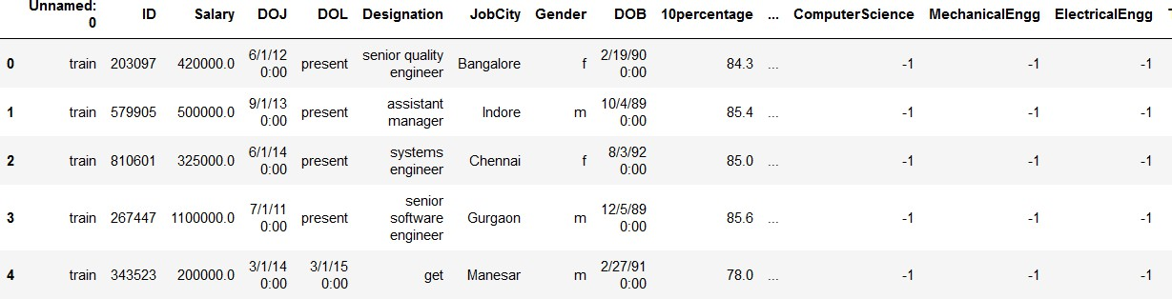
Dataset overview
Head of the dataset:
Shape of the data: (3998, 39)
Describing the data: Dataset has 10 float, 17 int and 12 object type features, with zero null values.

Slide 5
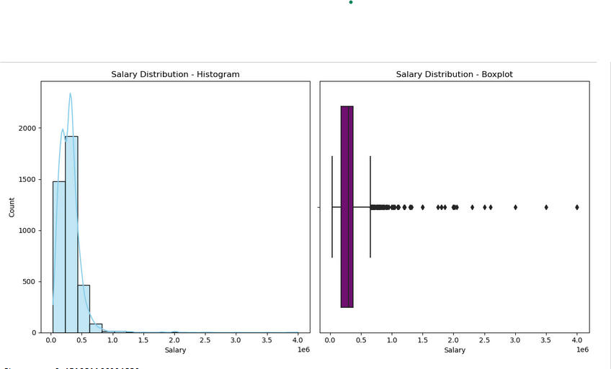
Univariate Analysis:
The distribution demonstrates positive skewness with a value of 6.45. This suggests that a majority of salaries are concentrated at the lower end, while a few instances exhibit exceptionally high salaries.
A total of 109 outliers were detected, showcasing salaries that significantly deviate from the general trend. Notable examples include salaries of 1,100,000, 800,000, and 1,500,000.
Majority of the employees are male
Analysis indicates that roles such as Data Scientist, Senior Developer, and Technology Lead rank among the top 20 positions commanding higher salaries in IT firms. These positions often involve specialized skills, technical expertise, and leadership responsibilities, correlating with increased compensation.
Positions like Branch Manager, Research Scientist, and Sales Account Manager prominently contribute to salary levels within
the IT industry. This highlights that leadership roles and specialized expertise play a significant role in determining salaries.

Slide 6
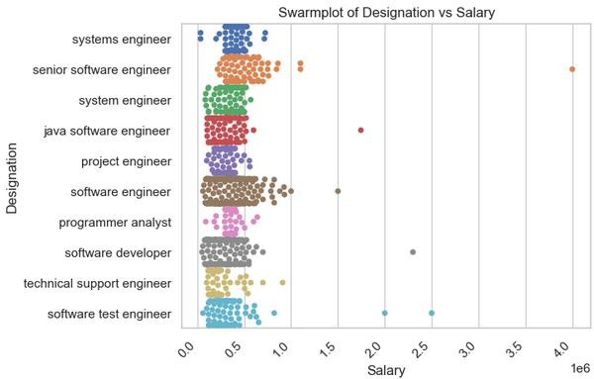
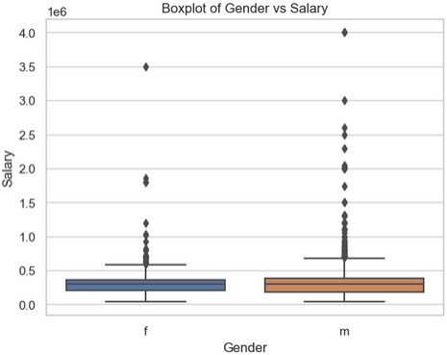
Bivariate Analysis:
Software engineers with senior ti tles tend to earn more.This i s likely because they
have more experience and expertise than those with morejunior ti tles. For example, in the plot, senior software engineers earn around $150,000 per year, while software engineers earn around $100,000 per year.
There i s a lot of variation in salary wi thin each designation. For example, some software engineers earn less than $75,000 per year, while others earn more than $200,000
per year. This variation is likely due to a number of factors, such as experience, education, location, and employer
There is a statistically s ignificant difference in salary between men and women. The
median salary for men i s higher than the median salary for women. The interquartile range (IQR) for men is also wider than the IQR for women, which suggests that there is
more variability in salaries for men.
The distribution of salaries is skewed for both men and women. This means that there are more people at the lower end of the salary range than at the higher end.There are outliers in both
groups. These are data points that fall outside the 1.5 IQR whisker range. Outliers can be caused by a number of factors, such as measurement error or extreme values.
.

Slide 7
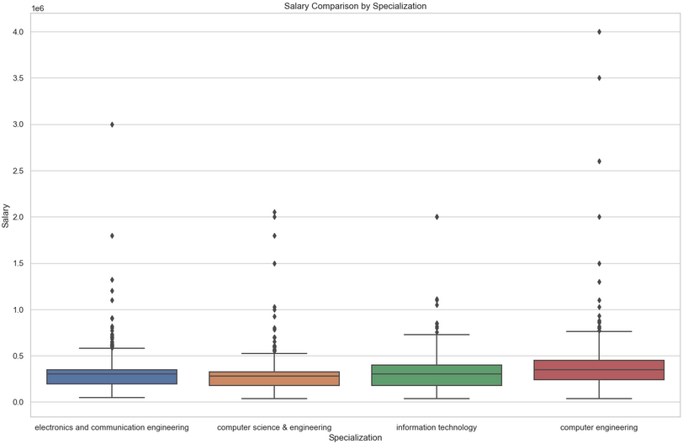
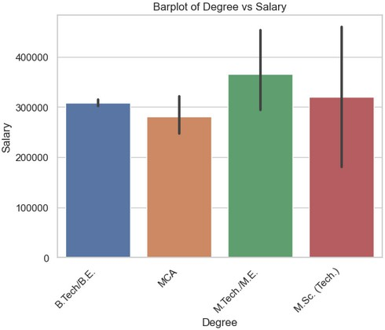
There is a significant difference in salary medians between the specializations. The highest median salary is for information technology, at
around $35,000 per year, while the lowest median salary is for electronics and communication engineering, at around $20,000 per year.
The salary distributions for all specializations are positively skewed. This means that there are more people at the lower end of the salary range
than at the higher end.
There is a positive correlation between degree and salary. This means that people with higher degrees tend to earn more money than people with lower degrees.
The salary distribution is skewed for all degrees. This means that there are more people at the lower end of the salary range than at the higher end.

Slide 8
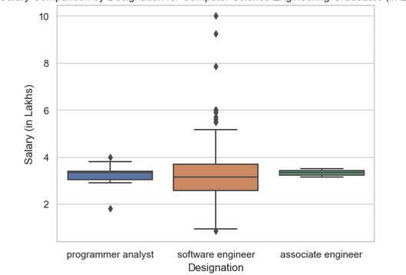
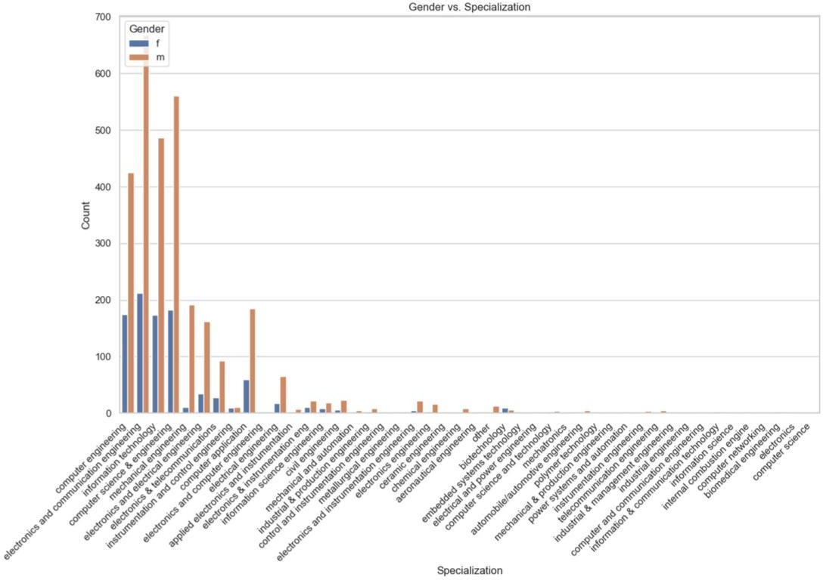
Research Questions:
From the analysis, Starting salaries for Computer Science graduates in India vary depending on the specific role. Fresh graduates in programming, software engineering, and associate engineer positions can expect ₹2.5-3 lakhs annually. However, data on hardware engineer salaries is scarce. To get a more accurate idea of what you might earn, consider factors like your location, the company's reputation, and the in-demand skills you possess. Internship experience can also be a major plus.
From this distribution, we can say male are doing more
specialization compared to female

Slide 9
Conclusion
Salary Distribution:
The pay for computer science engineers is not evenly spread (skewed). This means some people make much more or much less than the average.
Visualizations like histograms and box plots helped us find outliers, people whose salaries are very different from the rest.
Correlations:
There is a connection between scores on the "Quant," "Logical," and "English" tests and how much someone makes. People with higher scores tend to earn more.
Surprisingly, there seems to be a negative connection between salary and scores on the "Computer Science," "ID," and "CollegeTier" tests. People with higher scores in these areas earn less on average (investigate further).
Salary Expectations:
We checked The Times of India's claims about how much recent computer science graduates expect to make using real data.
Gender and Specialization:
While gender doesn't seem to affect how much someone can earn overall, women in the data tend to make less than the average.
Job Titles:
Most people in the dataset have the job title "Software Engineer".

Slide 10

Dhan'yavāda

